Slide 1

Healthcare Appointment Analysis Dashboard
Presented by: Mahak Jain
Tools Used: Power BI, Python

Slide 2

Project Overview
Objective:
To analyze healthcare appointment data and identify patterns in patient attendance behavior.
Key Features:
Predictive outcome tracking
SMS reminder analysis
Gender & age-based filtering
Weekly trend evaluation

Slide 3

Key Filters Used
Gender Filter: Segments data by Male (M) & Female (F)
Treatment Type Filter: Like Chemotherapy, ECG, MRI, Physiotherapy, X-Ray.
Note: Analyzes behavior based on treatment type.

Slide 4

Age Group Analysis
Visual: Clustered Column Chart
Insight:
Highest appointments in 19–35 age group.
Senior patients (60+) show fewer appointments.

Slide 5

Predicted Outcome Summary
Visual: Donut Chart
Insight:
58.82% of patients predicted to attend.
41.18% expected to no-show.
Useful for planning and scheduling.

Slide 6


Day-wise Outcome Analysis
Visual: Horizontal Bar Chart
Insight:
No-shows peak on Thursday and Friday.
Monday and Sunday show fewer no-shows.

Slide 7
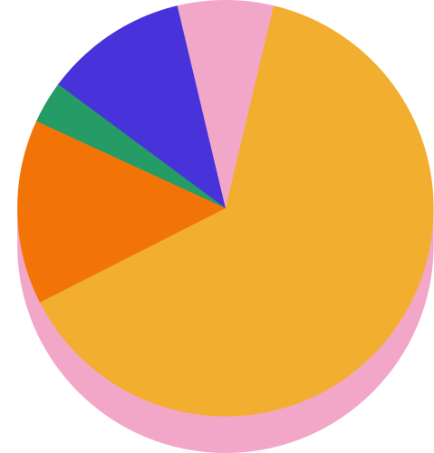
SMS Reminder Effectiveness
Visual: Pie Chart
Insight:
75% of patients with reminders attended.
SMS reminders have strong positive impact.

Slide 8

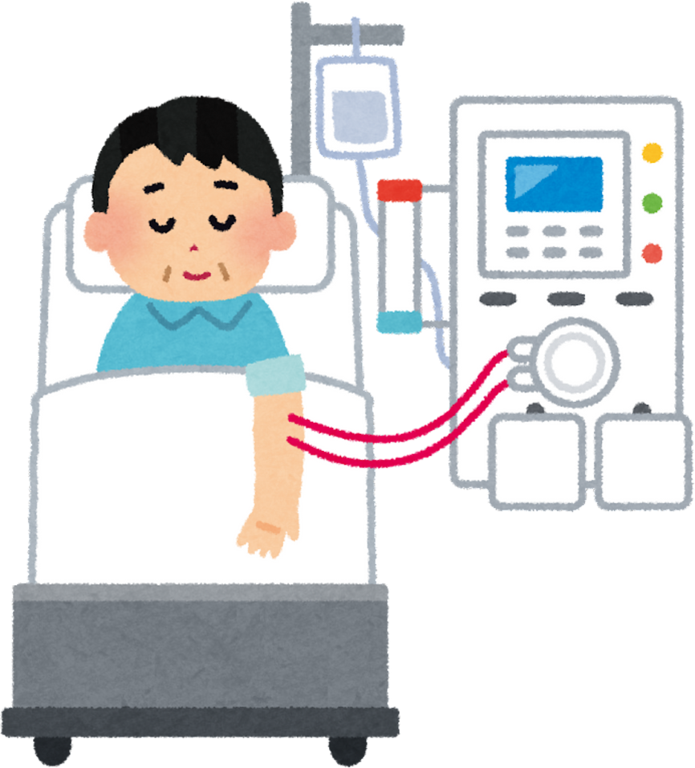
Conclusions & Recommendations
Conclusions:
Age and weekdays influence attendance.
SMS reminders boost attendance.
Recommendations:
Increase SMS use before high-risk days.
Focus on seniors and youth.
Schedule more on Monday/Sunday.

Slide 9
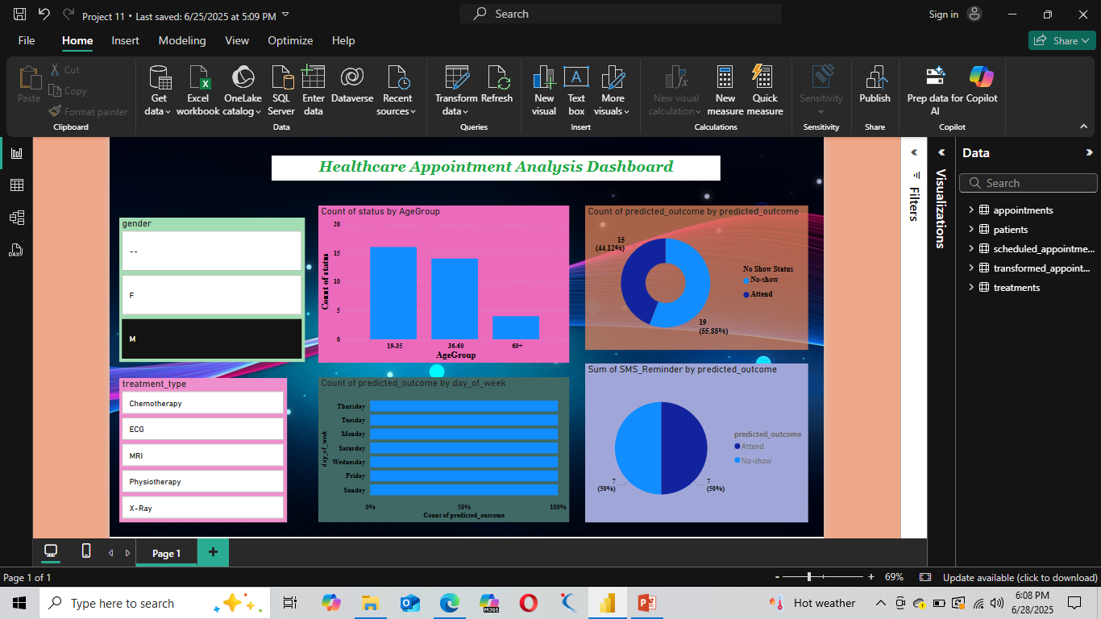
Dashboard

